Slide 1
ACT2111 Tutorial-Ch5
ACT2111 Teaching Team

Slide 2
Content
1. Recording transactions for a merchandising company
Recording purchases
Recording sales
Adjusting and closing entries
2. Income statement
3. Difficulties in tutorial questions

Slide 3
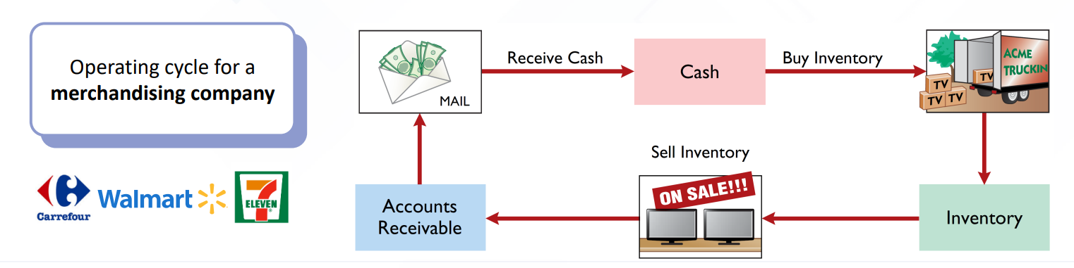
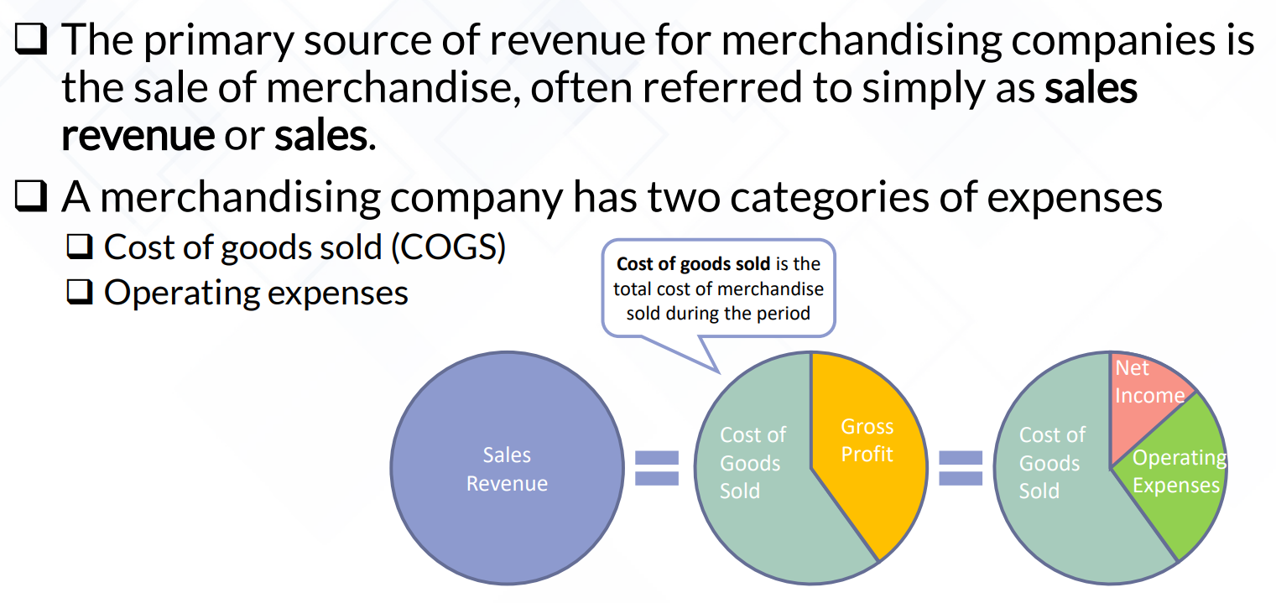
Merchandising company
Operating cycle
Income measurement

Slide 4
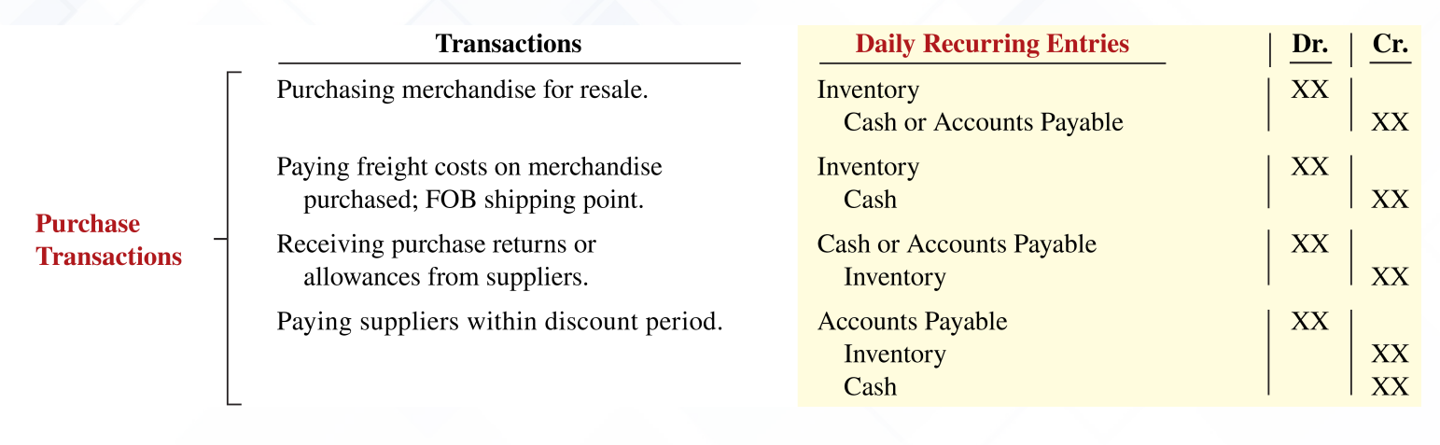
Recording purchases

Slide 5
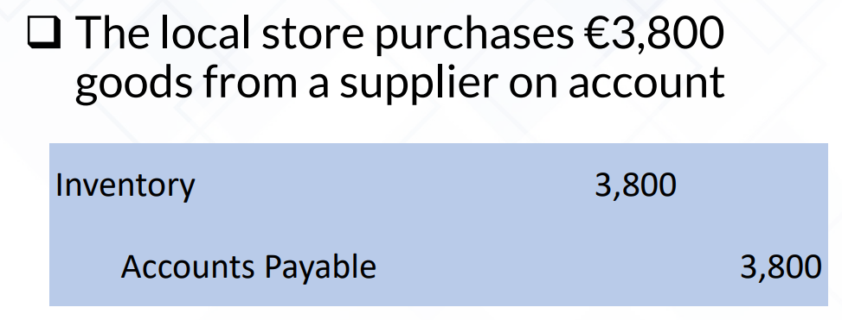

Recording purchases
Transaction 1: recording purchases
Dr. Inventory (amount: purchase price)
Cr. Accounts payable/ cash
Example

Slide 6
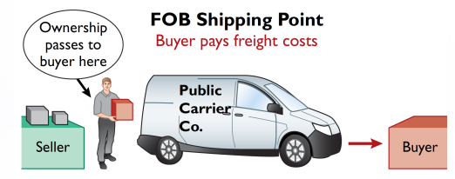
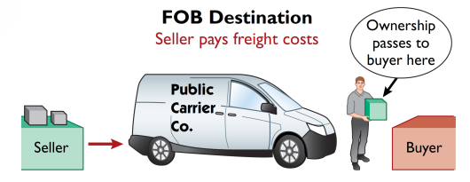
Recording purchases
Transaction 2: Freight costs
Dr. Inventory (amount: freight cost)
Cr. cash
Operating expense
Dr. Freight-Out (or Delivery Expense)
Cr. cash

Slide 7
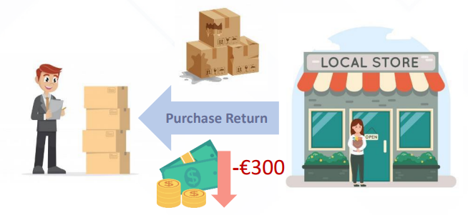
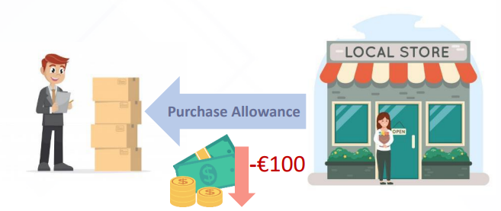
Recording purchases
Transaction 3: Purchase Returns and Allowances
➲ Purchase return
Dr. Accounts payable
Cr. Inventory
Purchase allowance
Buyer keeps the merchandise and the seller will grant a reduction of the purchase price
Dr. Accounts payable (amount: reduction granted)
Cr. Inventory

Slide 8
Recording purchases
Transaction 4: Purchase Discounts
➲ Credit terms may permit buyer to claim a cash discount for prompt payment
➢Terms:
2/10, n/30: 2% discount if paid within 10 days, otherwise net amount due within 30 days
1/10 EOM: 1% discount if paid within first 10 days of the next month
n/10 EOM: Net amount due within first 10 days of the next month
*discounts are applied to remaining balance of account payable
If pays within the required period----
Dr. accounts payable (amount: purchase price)
Cr. Inventory (amount: discount granted)
Cr. Cash
*Purchase discount is recorded as a reduction in the inventory cost

Slide 9
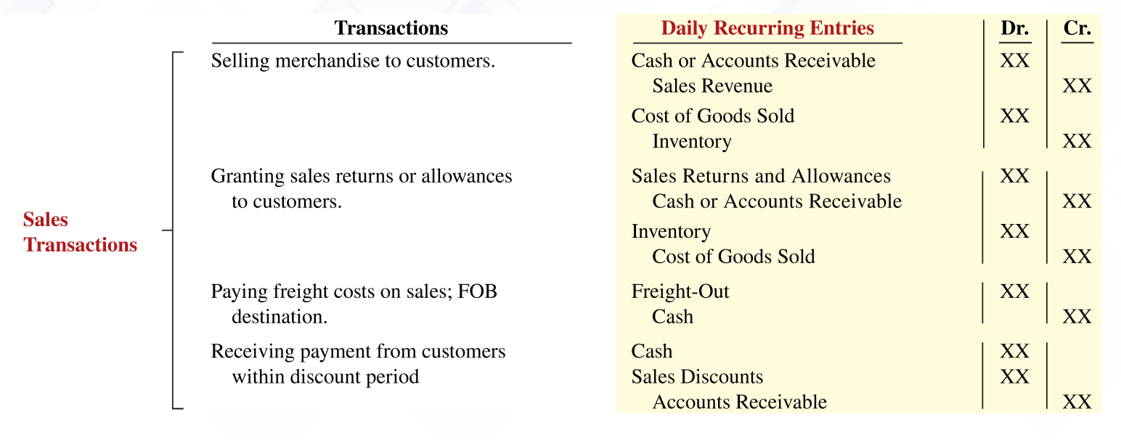
Recording sales

Slide 10
Recording sales
Transaction 1: Recording sales
Two entries are recorded: one for revenue, the other for inventory cost
Dr. Accounts receivable (amount: selling price)
Cr. Sales revenue
Dr. Cost of Goods Sold (amount: cost)
Cr. Inventory

Slide 11
Recording sales
Transaction 2: Sales Returns and Allowances
Case 1: goods returned and were not defective
❑ Sales Returns and Allowances is a contra revenue account
Dr. Sales Returns and Allowances
Cr. Accounts Receivable (amount: price of goods returned)
Dr. Inventory (amount: corresponding to goods returned)
Cr. Cost of Goods Sold
Case 2: goods returned and were defective
Dr. Sales Returns and Allowances
Cr. Accounts Receivable (amount: price of goods returned)
Dr. Inventory (amount: scrap value)
Cr. Cost of Goods Sold

Slide 12
Recording sales
Transaction 2: Purchase Returns and Allowances
Case 3: no goods returned, and the seller directly reduces the purchase price
Dr. Sales Returns and Allowances
Cr. Accounts Receivable (amount: purchase price reduction)

Slide 13
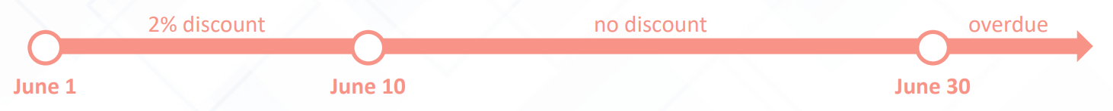
Recording sales
Transaction 3: Sales Discounts
(Example of a 2/10, n/30 timeline)
If customer pays within required period of time
Dr. cash
Dr. Sales Discounts (amount: discount amount)
Cr. Accounts Receivable (amount: net amount)
If customer pays after the discount period
Dr. Cash
Cr. Accounts Receivables

Slide 14
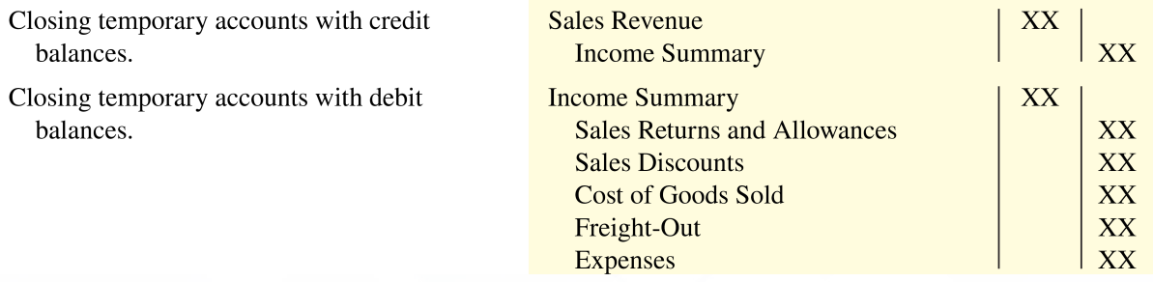
Adjusting Entries
Aim: make the recorded inventory amount agree with the inventory on hand
Dr. Cost of goods sold
Cr. Inventory (amount: difference between recorded and actual amount)
Closing Entries

Slide 15
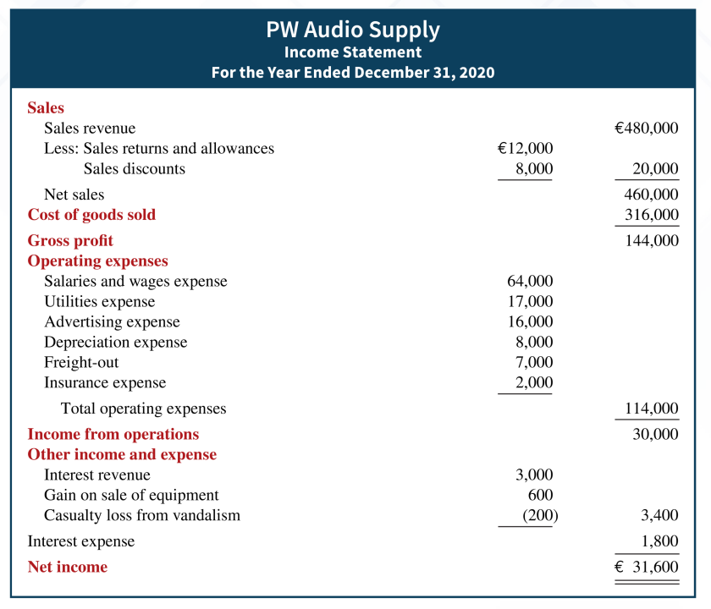
Income statement
Net sales = Sales revenue – Sales returns
and allowances – Sales discounts
Gross profit = Net sales – Cost of goods sold Gross profit rate = Gross profit / Net sales
Income from operations = Gross profit –
Total operating expenses
Other Income: Interest revenue, Dividend revenue,
Rent revenue, Gain from the sale of PP&E
Other Expense: Casualty losses, Loss from the sale of PP&E, Loss from strike
Interest Expense: arising from financing activities

Slide 16
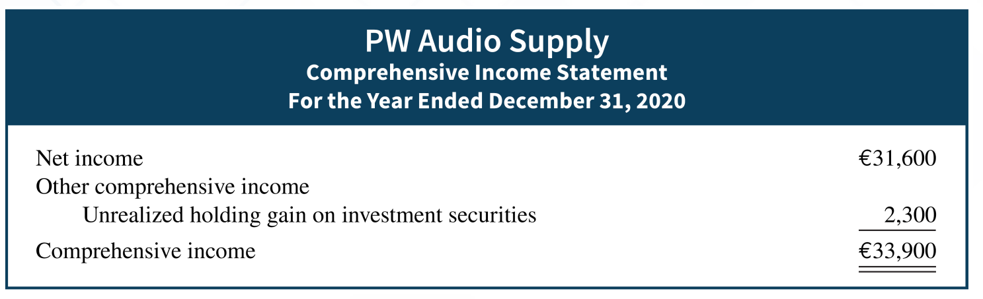
Comprehensive income
Examples:
➲ adjustments to pension plan assets
➲ gains and losses on foreign currency translation
➲ unrealized gains and losses on certain types of investments

Slide 17
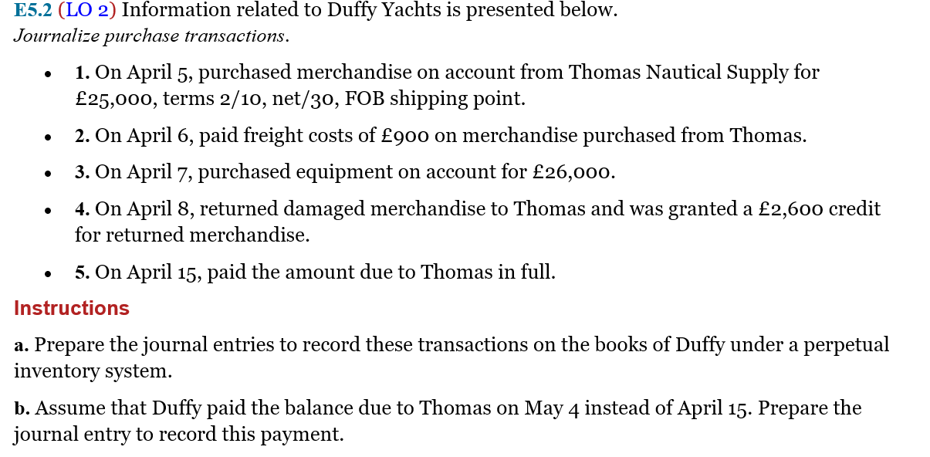
Difficulties in tutorial questions

Slide 18
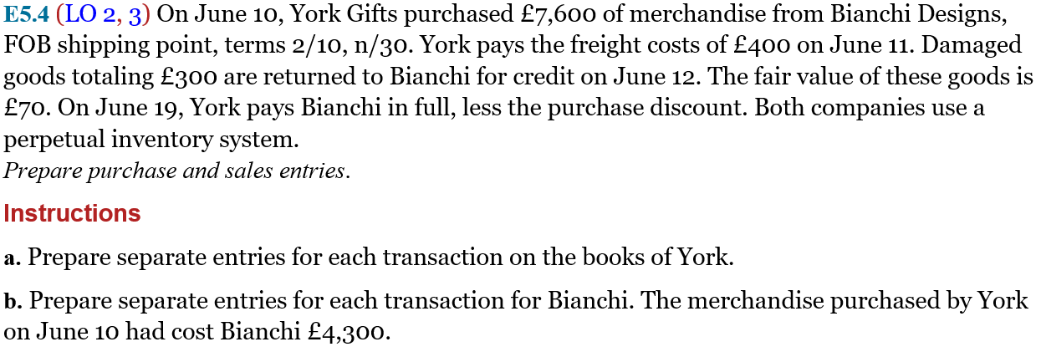
Difficulties in tutorial questions

Slide 19
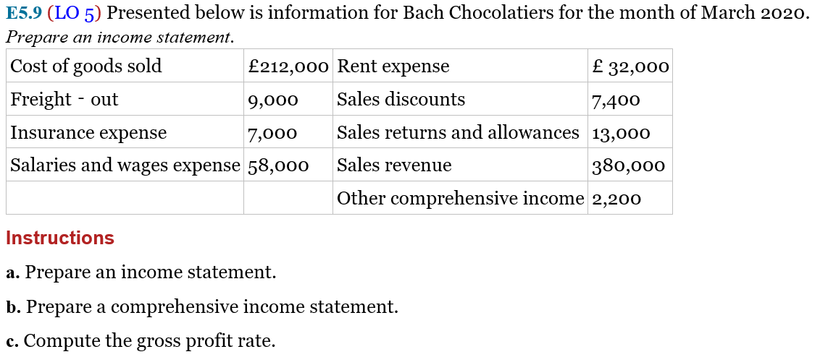
Difficulties in tutorial questions

Slide 20
Thanks for your listening!

